Slide 1
Employee salary presdiction
CAPSTONE PROJECT
Presented By:
1. Student Name-College Name-Department

Slide 2
OUTLINE
Problem Statement (Should not include solution)
System Development Approach (Technology Used)
Algorithm & Deployment (Step by Step Procedure)
Result
Conclusion
Future Scope(Optonal)
References

Slide 3
Problem Statement
This project focuses on predicting employee salary levels using machine learning techniques. Organizations often face challenges in identifying fair salary bands for employees across various roles, locations, and qualifications. Manual estimation can be biased and inefficient, especially with large volumes of HR data. This system aims to automate salary prediction based on demographic and professional features like age, gender, education level, job title, experience, and working hours. The goal is to assist HR professionals in making data-driven compensation decisions, ensuring fairness, competitiveness, and transparency in the hiring process.

Slide 4
System Approach
Hardware:
Processor: Intel i5 or higher
RAM: Minimum 8 GB
Storage: At least 1 GB free disk space
Software:
OS: Windows/Linux/MacOS
Python 3.7 or higher
Web Browser (for Streamlit interface)
📚 Libraries Required
pandas – for data manipulation and preprocessing
numpy – for numerical operations
scikit-learn – for building and evaluating machine learning models
xgboost, lightgbm, catboost – for advanced boosting algorithms
joblib – for saving and loading the trained model
streamlit – for developing the interactive web interface
matplotlib / seaborn

Slide 5
Algorithm & Deployment
Data Loading Load the income dataset (CSV) using pandas.
Data Preprocessing Handle missing values, encode categorical features, and normalize numeric data.
Feature Engineering Drop irrelevant columns and prepare features for training.
Model Training Train and compare multiple ML models:
KNN, Decision Tree, Random Forest, Extra Trees
Logistic Regression, Naive Bayes, MLP
XGBoost, LightGBM, CatBoost, HistGradientBoosting
Stacking Classifier (Ensemble)
Model Evaluation Use accuracy, precision, recall, F1-score to select the best model.
Model Saving Save the best model using joblib.
Deployment with Streamlit Build a simple UI to input features and display income prediction.
Hosting Run locally or host on Streamlit Cloud/Render/Heroku.

Slide 6
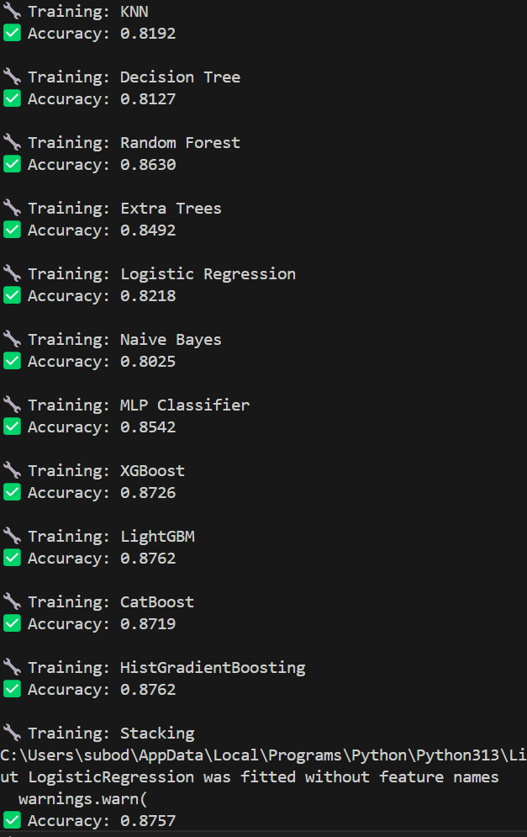

Result

Slide 7
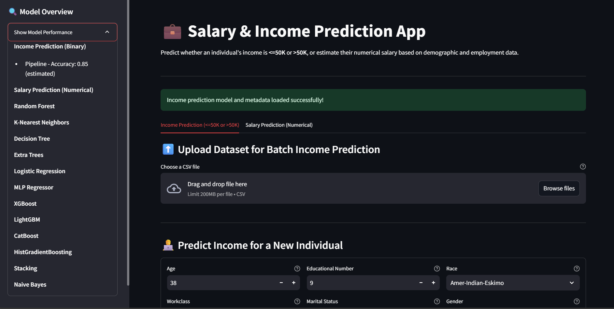
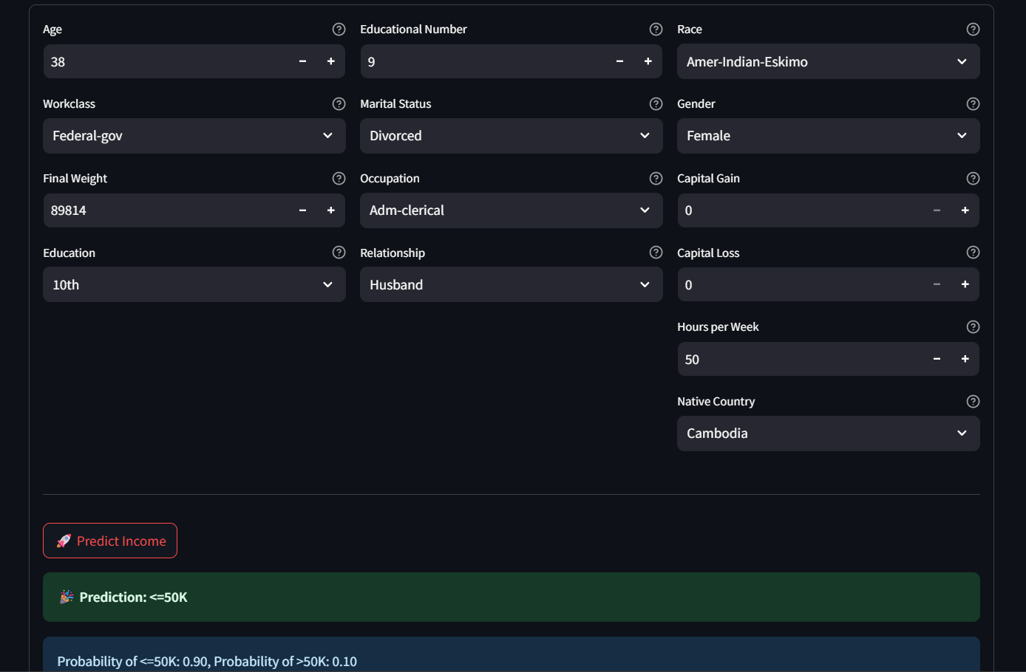
Results

Slide 8
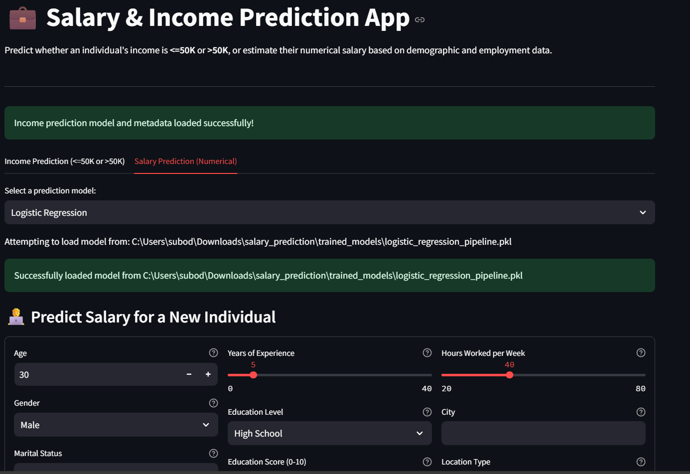
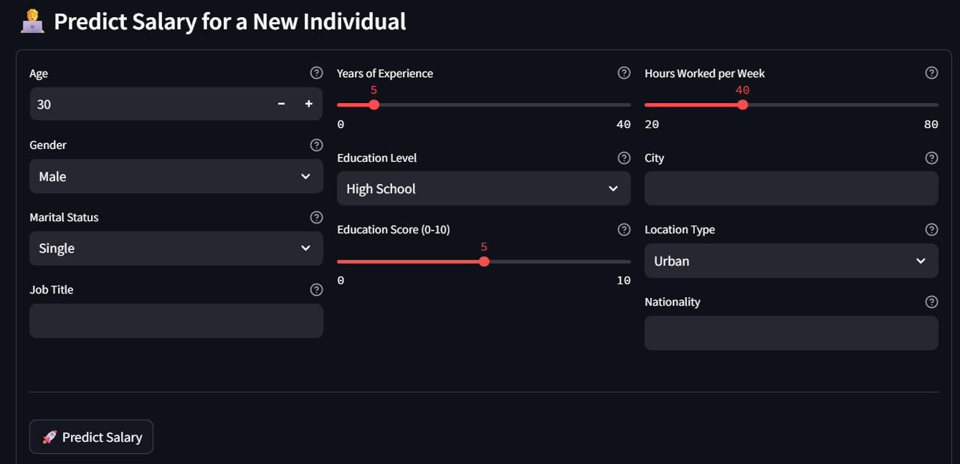
Results

Slide 9
GITHUB LINK
https://github.com/subodhswaroopachar/EDUNET-IBM.git

Slide 10
Conclusion
The proposed salary prediction system effectively uses various machine learning models to predict employee income based on demographic and professional attributes. Among the tested models, ensemble methods like Random Forest, XGBoost, and StackingClassifier showed high accuracy and generalization performance.
The project demonstrated how automation and machine learning can reduce bias and assist HR teams in fair compensation planning. Challenges encountered included handling imbalanced classes and optimizing hyperparameters for each model. These were addressed through preprocessing, scaling, and careful model tuning.
In future versions, incorporating external datasets (like market salary trends), adding explainability (e.g., SHAP values), and integrating it with real-time HR systems can further improve utility and accuracy.

Slide 11
References
Scikit-learn: Machine Learning in Python Pedregosa, F., Varoquaux, G., Gramfort, A., et al. (2011). Scikit-learn: Machine Learning in Python. Journal of Machine Learning Research, 12, 2825–2830. https://scikit-learn.org
XGBoost: A Scalable Tree Boosting System Chen, T., & Guestrin, C. (2016). Proceedings of the 22nd ACM SIGKDD International Conference on Knowledge Discovery and Data Mining, 785–794. https://doi.org/10.1145/2939672.2939785
LightGBM: A Highly Efficient Gradient Boosting Decision Tree Ke, G., Meng, Q., Finley, T., et al. (2017). Advances in Neural Information Processing Systems, 30. https://proceedings.neurips.cc/paper_files/paper/2017/file/6449f44a102fde848669bdd9eb6b76fa-Paper.pdf
CatBoost: unbiased boosting with categorical features Prokhorenkova, L., Gusev, G., Vorobev, A., et al. (2018). Advances in Neural Information Processing Systems, 31. https://proceedings.neurips.cc/paper_files/paper/2018/file/14491b756b3a51daac41c24863285549-Paper.pdf
UCI Machine Learning Repository: Adult Dataset (Income Prediction) Dua, D. and Graff, C. (2019). UCI Machine Learning Repository. University of California, Irvine, School of Information and Computer Sciences. https://archive.ics.uci.edu/ml/datasets/adult

Slide 12
THANK YOU

